Slide 1
Predicting credit card default
A Comparative Analysis of Parameter and Nonparametric Classification Techniques
Data 621 – Final Project
Group #2
5/25/2018

Slide 2
Objectives
Build and explore multiple classification models to predict default on credit card payment
Determine the best performing model

Slide 3
Team
Valerie Briot
Keith Folsom
Sharon Morris
Brian Kreis
Michael D’Acampora

Slide 4
Methodology
Perform detailed data exploration (EDA) to understand characteristics of the data
Build multiple binary classification models using both parametric and non-parametric techniques
Use each model to predict against the same test dataset
Compare models based on performance criteria
Select the best performing model

Slide 5
Data Exploration
Our Data Set: UCI default credit card clients dataset
Consists of monthly payment data of credit cardholders with a binary response variable (Default=1, non-default=0)
Data set contained 30,000 total observations of which 6,636 observations with Default = 1 (28%)
Need to recode some of the predictors into dummy variables
Some predictors were highly correlated and we found it necessary to create new predictors

Slide 6
Model Selection Criteria
F1-score: the harmonic mean of precision and recall
Kappa Statistic: a measure of accuracy that takes into consideration possible accuracy generated due to chance
Sensitivity: rate of event of interest (default) is correctly predicted within the sample
Specificity: rate of non-event (not default) is correctly predicted within the sample
Balanced Accuracy: (Sensitivity + Specificity) ÷ 2
False Positive Rate: (1 – Specificity)
Youden’s Index: evaluates the ability of a classifier to avoid misclassification

Slide 7
Models Design
We selected to build the following models:
  Binary Logistic Regression
  Ridge and Lasso Regularization
  Decision Tree
  Neural Network

Slide 8
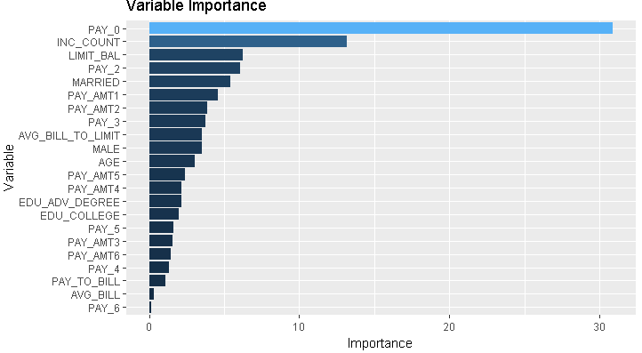
Binary Logistic Regression
Balanced Accuracy = 0.774 False-Positive Rate = 0.177

Slide 9
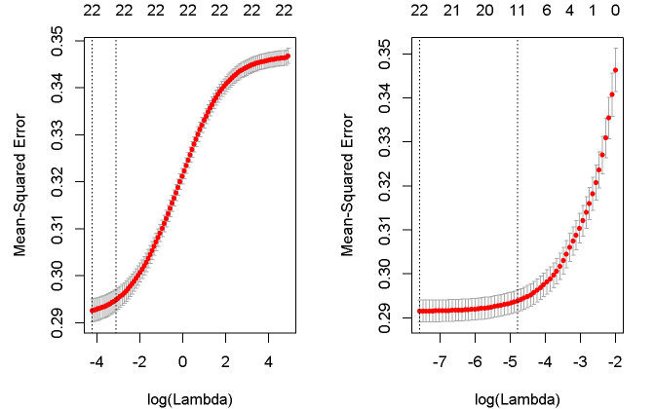
Ridge-Lasso Regularization
Ridge - Balanced Accuracy = 0.766 False-Positive Rate = 0.182
Lasso - Balanced Accuracy = 0.78 False-Positive Rate = 0.182
Ridge Optimal λ
Lasso Optimal λ

Slide 10
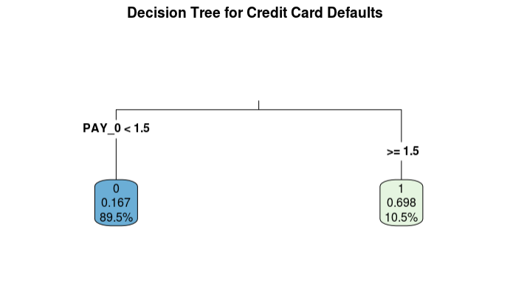
Decision Tree
Balanced Accuracy = 0.764 False-Positive Rate = 0.163

Slide 11
Neural Networks
Balanced Accuracy = 0.757 False-Positive Rate = 0.16
Neural Network Plot

Slide 12
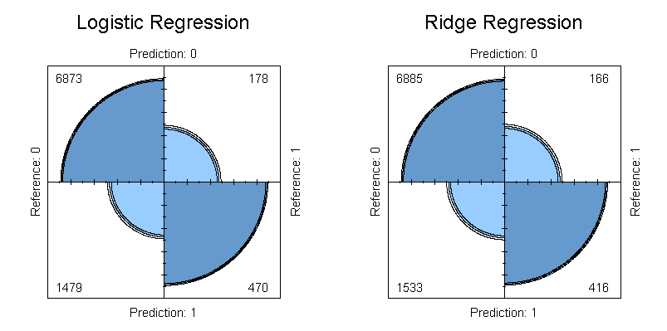
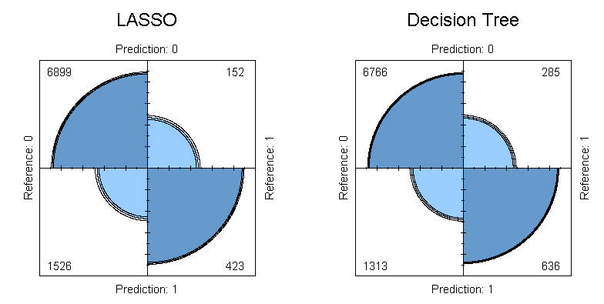
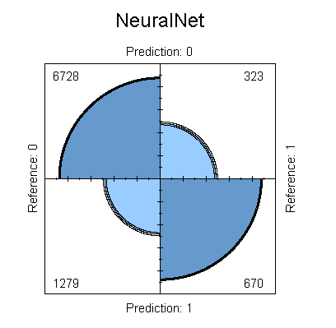
Model Comparison
Confusion Matrix for each model against the test dataset

Slide 13
Conclusion
Neural Network model was the best performing model
  Decision Tree model was the second best performing model
Non-parametric models outperformed parametric models
Noted concerns with being able to apply the model outside of the dataset due to some following reasons:
  Data set was unbalanced (28%=Default/72%=Not Default)
  Data set was not representative of wider population
  (Mostly young Educated customers)
Further research and exploration in trying to predict time prior to event (Default) using survival model
  we would need additional data

